Slide 1
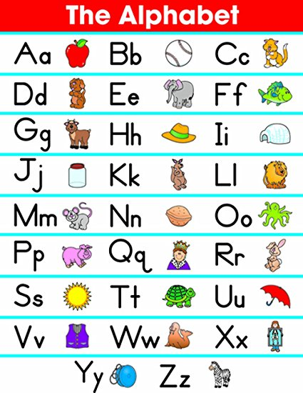

Slide 2
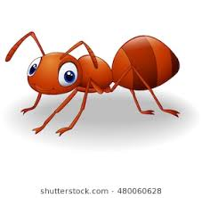
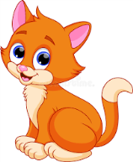
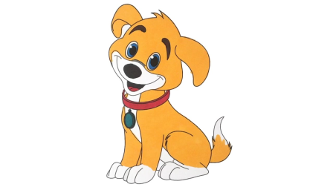
ALPHABET LESSON
Aa Ant ant
Bb Boy boy
Cc Cat cat
Dd Dog dog

Slide 3
ALPHABET LESSON
5. Ee Egg egg
6. Ff Frog frog
7. Gg Girl girl
8. Hh Hat hat
9. Ii Idea idea

Slide 4
10. Jj Jam jam
11.Kk King king
12. Ll Lamp lamp
13.Mm Man man
14. Nn Net net

Slide 5
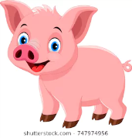
ALPHABET LESSON
15. Oo Octopus octopus
16. Pp Pig pig
17. Qq Queen queen
18. Rr Rabbit rabbit
19. Ss Star star

Slide 6
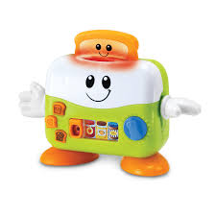
ALPHABET LESSON
20. Tt Toy toy
21. Uu Umbrella umbrella
22. Vv Van van
24. Ww Woman woman
25. Xx X-ray x-ray

Slide 7
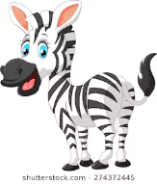
ALPHABET LESSON
26. Yy Yo-yo yo-yo
27. Zz Zebra zebra

