Slide 1
Welcome Everyone
To our first online meeting

Slide 2
In this course we are going to learn about FOOD AND LANGUAGE

Slide 3
Let’s Introduce ourselves

Slide 4
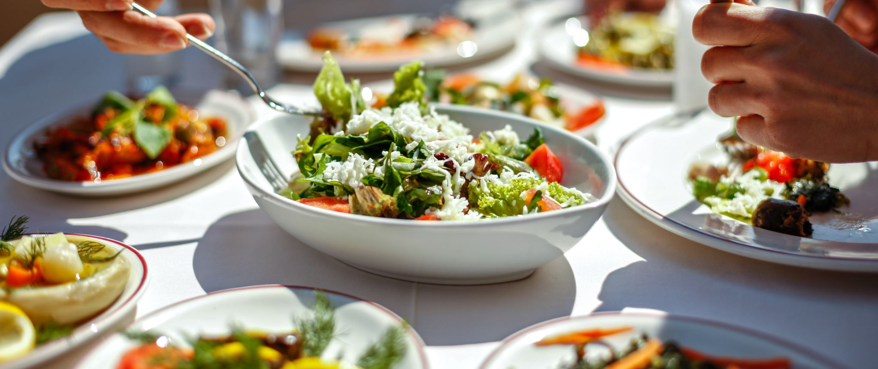
Can you describe your favourite food?

Slide 5
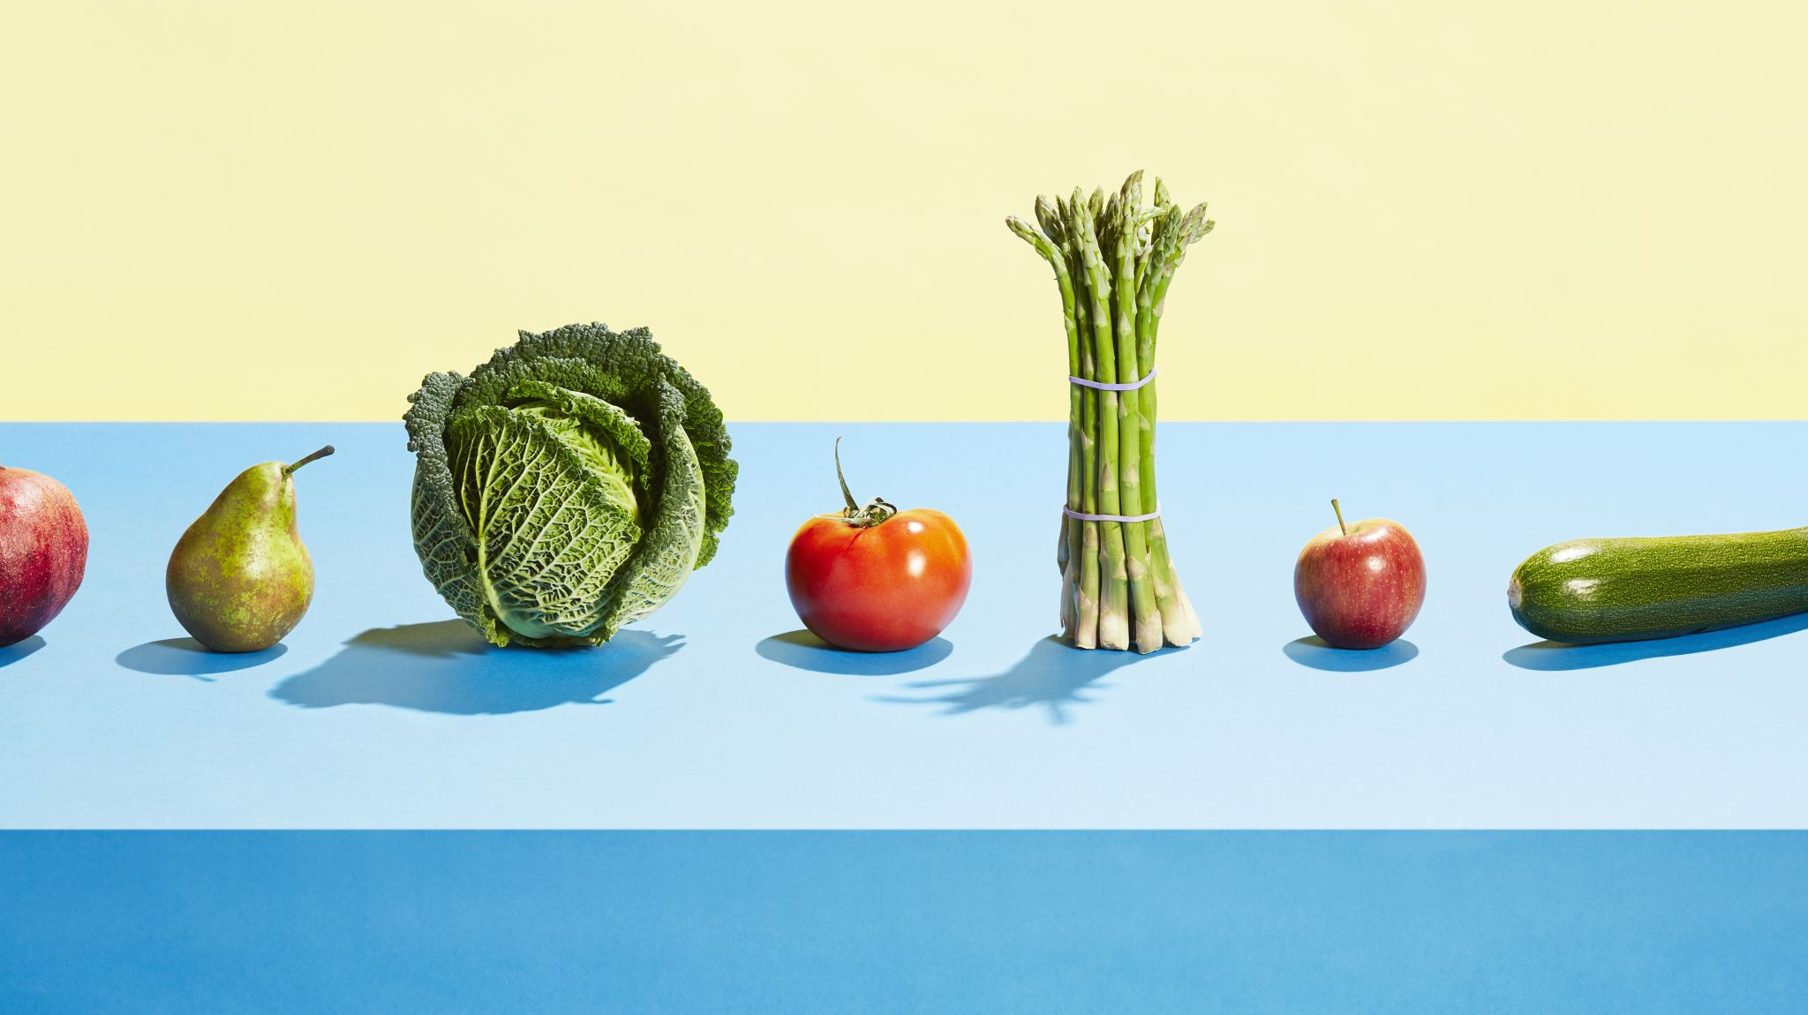
What does culinary mean ? Definition: Related to cooking or the art and practice of preparing food. Example Sentence: "The culinary class teaches students how to create delicious meals and explore the wonderful world of cooking."

Slide 6
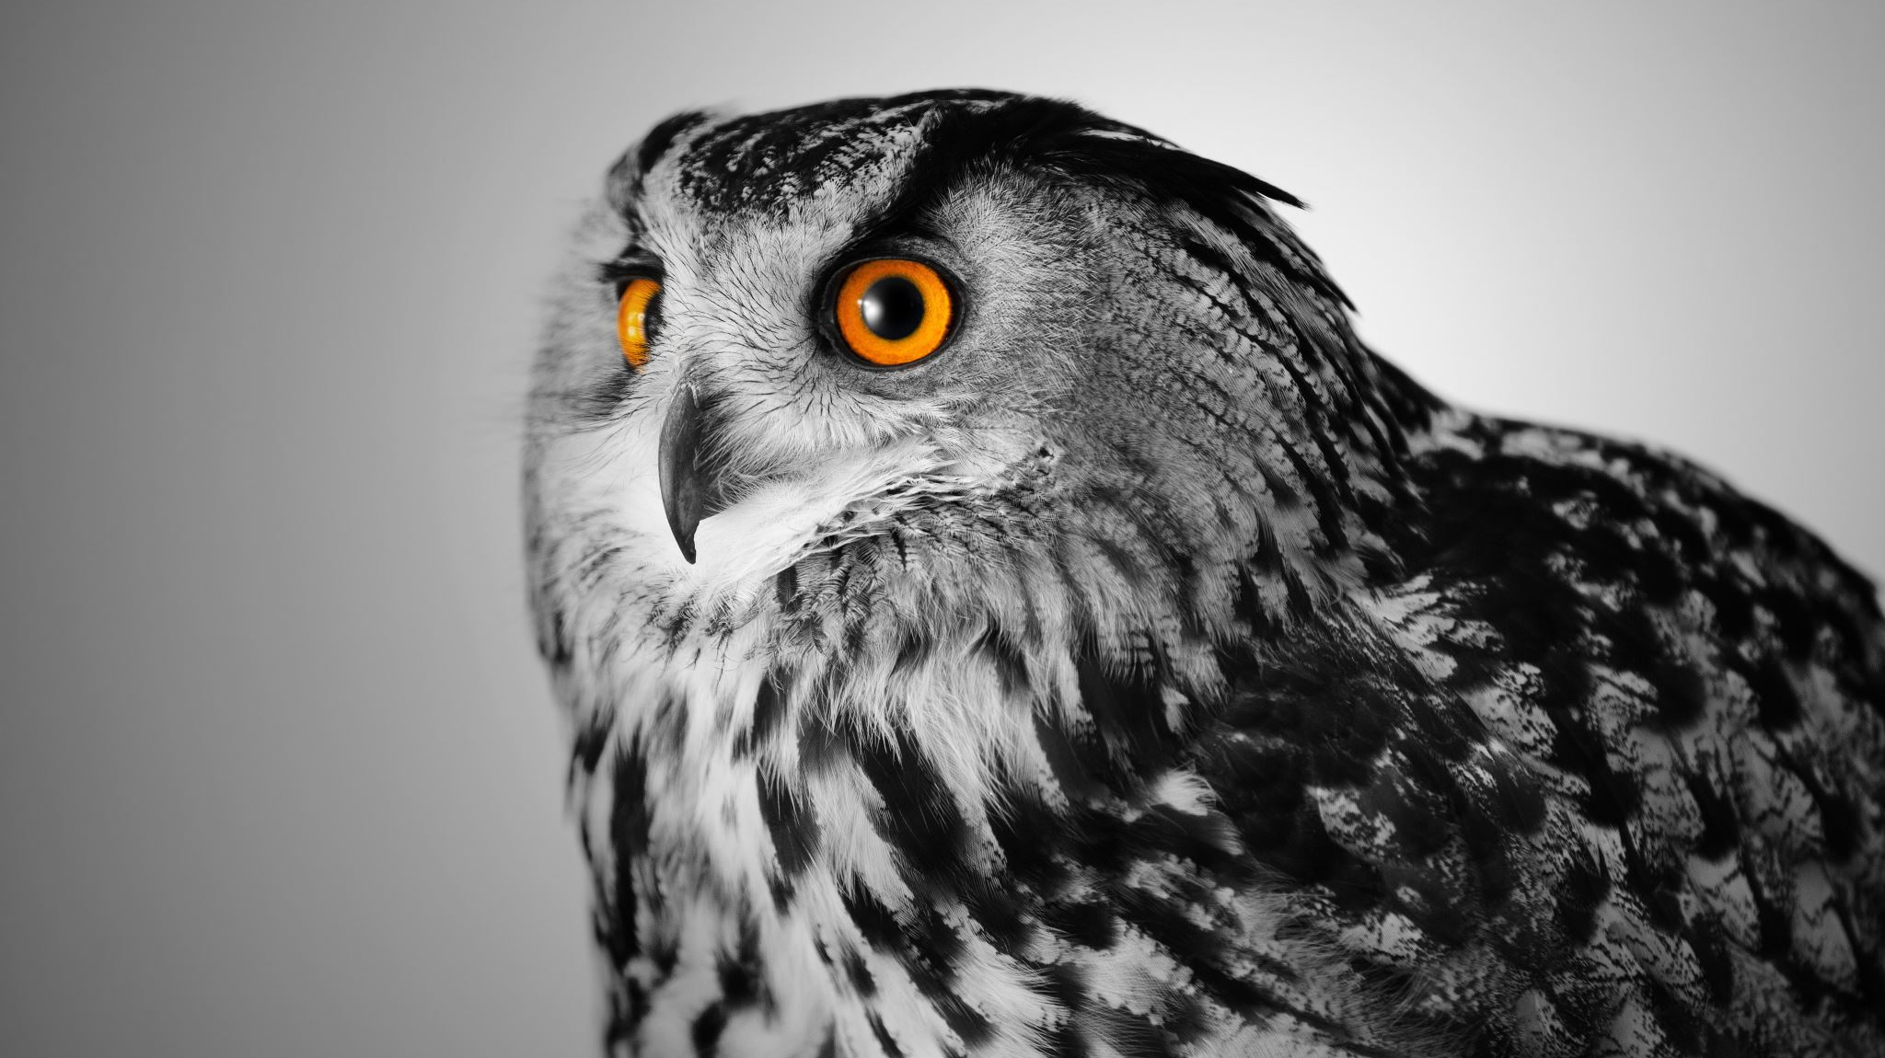
Our class Syllabus

Slide 7
Final Presentation Make Groups and Collaborate!

Slide 8
By the end of the course:
Your culinary vocabulary will improve and so will your ability to have real world communication, knowing all that is necessary when speaking about food.

Slide 9
See you all next week!!

