Slide 1
At the supermarket
PRODUCTS

Slide 2
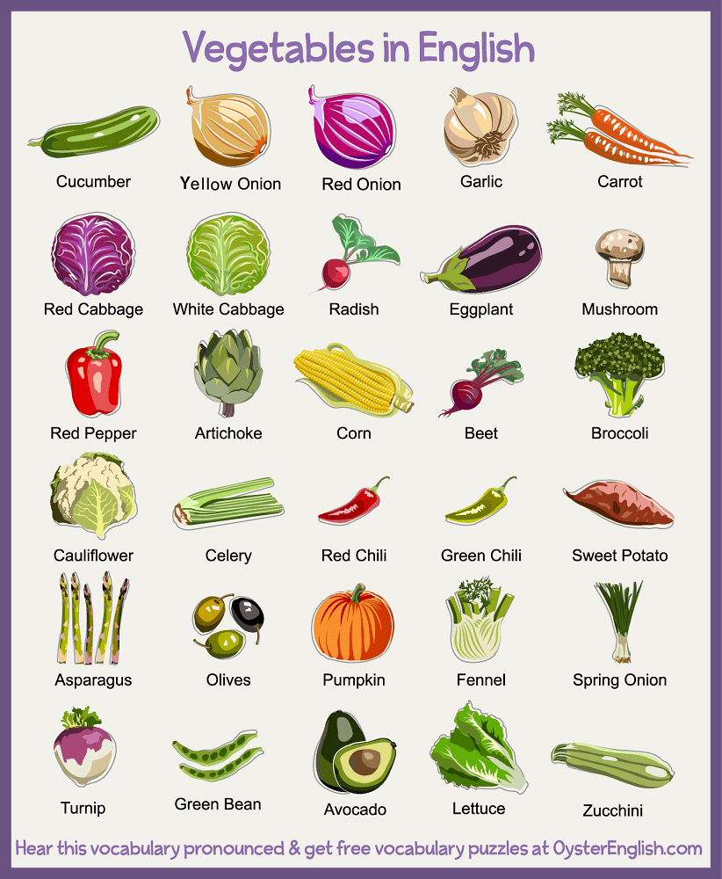
Fresh produce – Vegetables

Slide 3
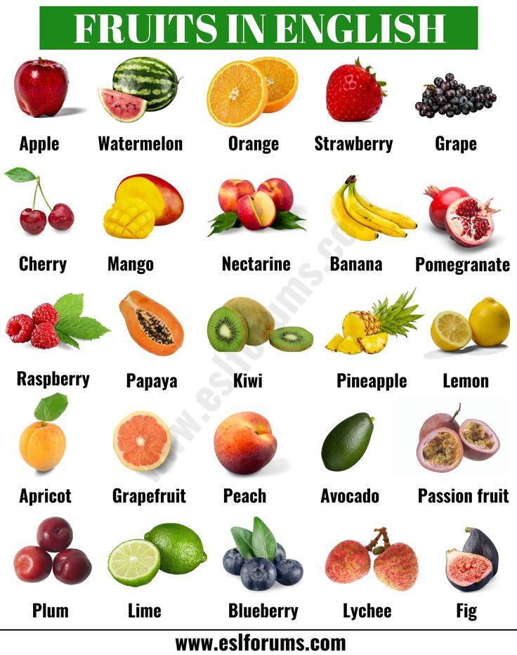
Fresh produce - Fruit

Slide 4
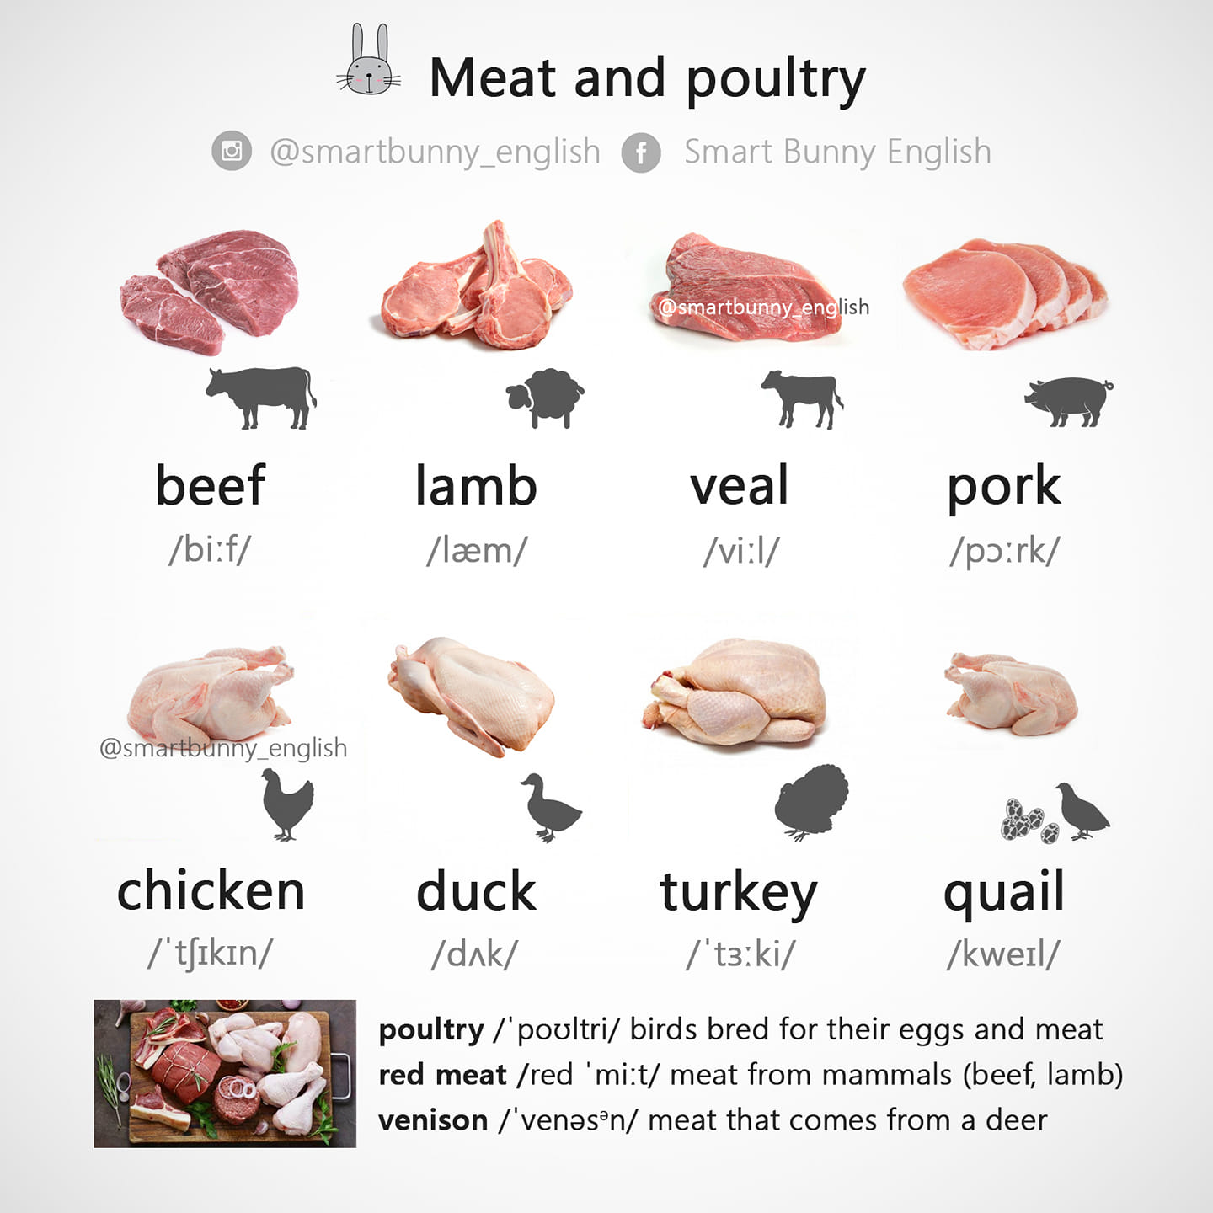
Meat and Poultry

Slide 5
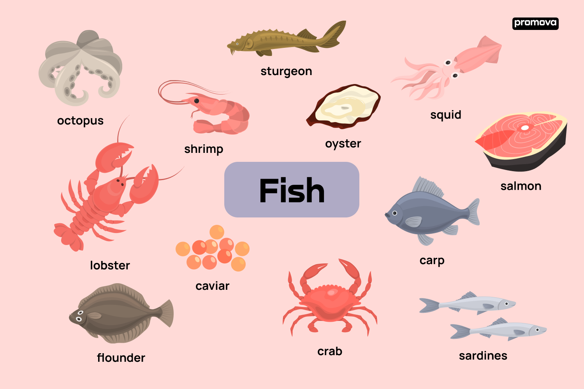
Seafood

Slide 6
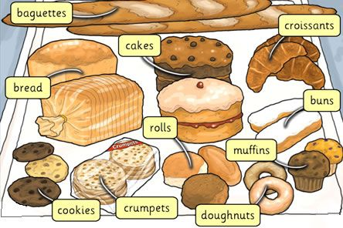
Bakery

