Slide 1
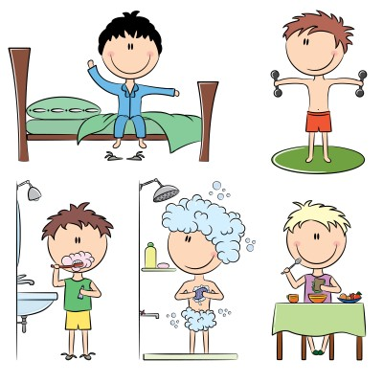
The Simple Present

Slide 2
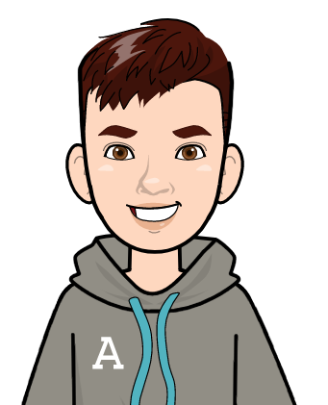
My Day
I get up at 7:00 and get ready for school. I have breakfast and then I brush my teeth. At 7:30 I walk to school with my brother.
School starts at 8:00 a.m. and finishes at 13.30 in the afternoon. My brother and I walk home, and we have lunch with our grandparents.
In the afternoon I do my homework and then I play board games with my grandpa, or I read comic books. After that, I take a shower and then I have dinner. At 9.30, I brush my teeth and then I go to bed!
Alex, 10, Athens

Slide 3
The Simple Present - Affirmative
We use the Simple Present to talk about:
daily habits. (συνήθεια)
You brush your teeth every morning.
states and general truths. (αλήθεια)
I have two sisters.
He lives in Athens.

Slide 4
How to form
I - You - We - They
To form the Simple Present Affirmative, you need a noun or pronoun and the verb .
I walk
You walk
We walk
They walk
Remember
A noun is an object or the name of a person, place etc. (ex. George, Ms Harrison, Paris)
A (personal) pronoun is
I, You, He, She, It, We, You , They

Slide 5
How to form
He - She - It
To form the Simple Present Affirmative, you need a noun or pronoun, the verb , and AND a final -s.
He walks
She walks
It walks

Slide 6
The Simple Present - Affirmative
I walk
You walk
He walks
She walks
It walks
We walk
You walk
They walk

Slide 7
Spelling Rules for adding final -s
When a verb ends in -sh, -ch, -x, -ss or -o
we add –es
Ex. wash + s = washes
go + s = goes
When a verb ends in –y and
the letter before it is a consonant (σύμφωνο), drop the y and add –ies
Ex. study + s = studies
BUT if the letter before y is a vowel (φωνήεν), just add –s
Ex. stay + s = stays

Slide 8
Spelling Rules for adding final -s
In any other case just add -s
Ex. make + s = makes
start + s = starts
stop + s = stops

Slide 9
The Simple Present - Interrogative
To form a question in the Simple Present we need the help of the verb do:
For I - You - We – They
Do you play chess?
He - She - It
Does he make jokes?
Does she live near you?
Be careful !
Notice how in he-she-it the helping verb do has the final -s from the verb now.
There is no -s in the verb anymore!
Remember the spelling rules, when a verb ends in –o we add –es.

Slide 10
The Simple Present – Short answers
To give a short answer in the Simple Present:
For I - You - We – They
Do you play chess?
Yes, I do. - No, I don’t.
He - She - It
Does he make jokes?
Yes, he does. No, he doesn’t.

Slide 11
The Simple Present - Negative
To form a negative in the Simple Present, again we need the help of the verb do and the word not:
For I - You - We – They
We do not like rain.
He - She - It
He does not wear glasses.
She does not cook.
Note!
There is also a short version of the negative:
I don’t like, he doesn’t like
Tip!
Write the two words as one and instead of the ‘o’ use an apostrophe:
I donot = I don’t
He doesnot = He doesn’t

Slide 12
The Simple Present -
I cook
You cook
He cooks
She cooks
It cooks
We cook
You cook
They cook
Do I cook?
Do you cook?
Does he cook?
Does she cook?
Does it cook?
Do we cook?
Do you cook?
Do they cook?
I don’t cook
You don’t cook
He doesn’t cook
She doesn’t cook
It doesn’t cook
We don’t cook
You don’t cook
They don’t cook

