Slide 1
My Daily Routine
Anastasia Rapti –Dimitra Synteli

Slide 2
What is a daily routine?
A daily routine refers to the everyday activities done by any person. It is something that you do every day at a specific time.

Slide 3
How to describe your daily routines correctly:
Use the subject pronouns: I, you, he/she/it, we, you, they.
Use the Present Simple Tense.
Use the Adverbs of Frequency (always, usually, sometimes, often, rarely, never, etc).
Example: I always brush my teeth in the morning.

Slide 4
Daily Routine Examples

Slide 5
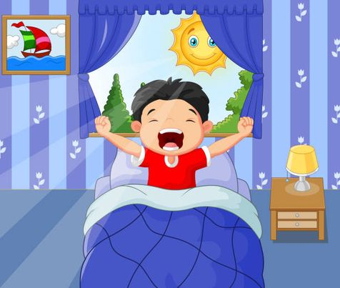
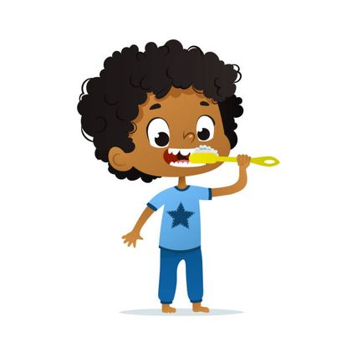
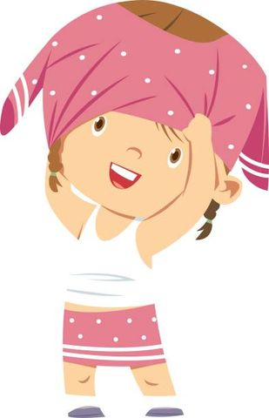
Wake up
Brush my teeth
Get dressed

Slide 6
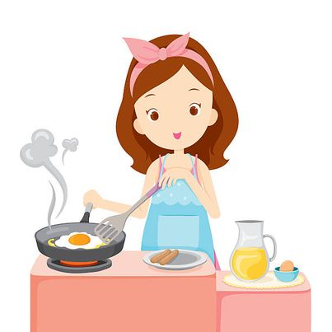
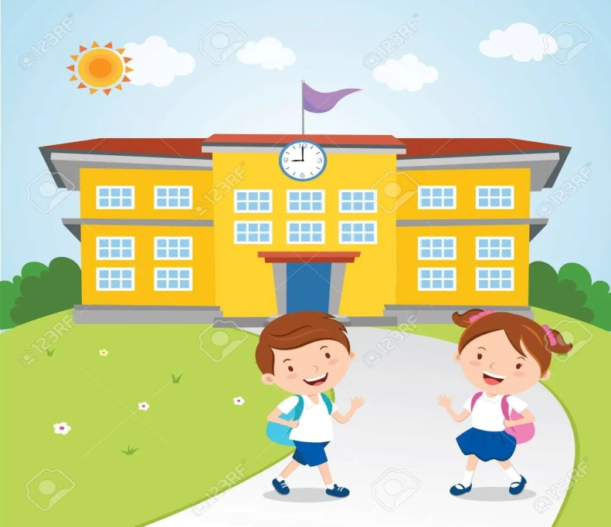
Make breakfast/lunch/dinner
Take the bus
Go to school

Slide 7
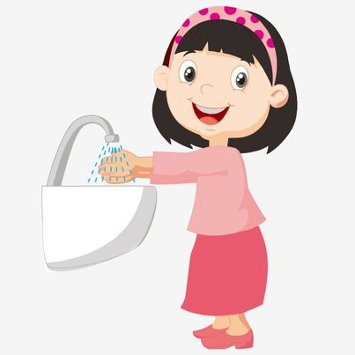
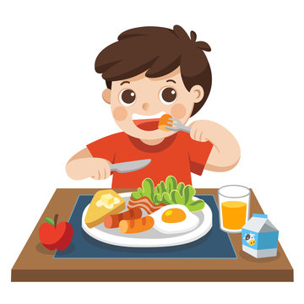
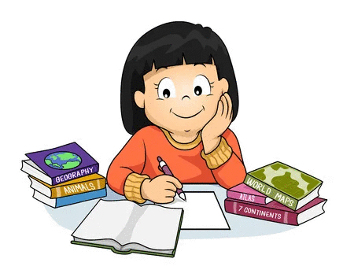
Wash my hands
Have breakfast/lunch/dinner
Do my homework

Slide 8
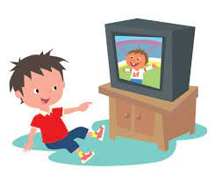
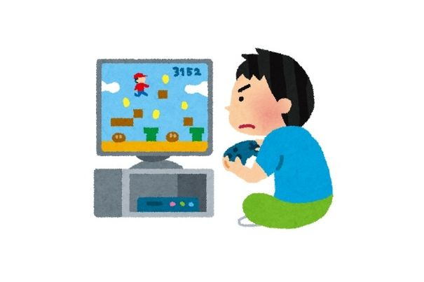
Watch TV
Play video games
Read a book

Slide 9
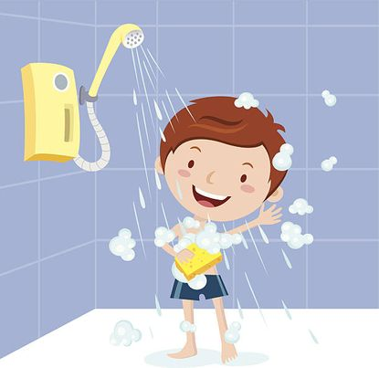
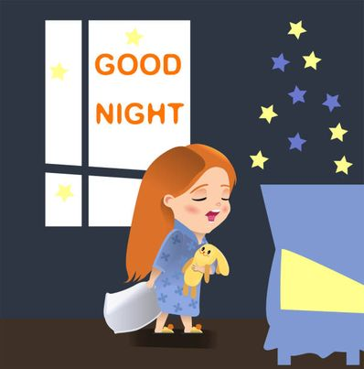
Take a shower
Go to bed

Slide 10
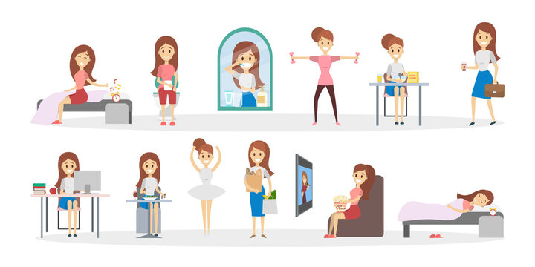
Thank you!!!
Rapti Anastasia – Synteli Dimitra

