Slide 1
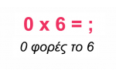
Οι Πίνακες του Πολλαπλασιασμού
Από το 1 έως το 10

Slide 2

Πίνακας του 1
1 × 1 = 1
1 × 2 = 2
1 × 3 = 3
1 × 4 = 4
1 × 5 = 5
1 × 6 = 6
1 × 7 = 7
1 × 8 = 8
1 × 9 = 9
1 × 10 = 10

Slide 3

Πίνακας του 2
2 × 1 = 2
2 × 2 = 4
2 × 3 = 6
2 × 4 = 8
2 × 5 = 10
2 × 6 = 12
2 × 7 = 14
2 × 8 = 16
2 × 9 = 18
2 × 10 = 20

Slide 4

Πίνακας του 3
3 × 1 = 3
3 × 2 = 6
3 × 3 = 9
3 × 4 = 12
3 × 5 = 15
3 × 6 = 18
3 × 7 = 21
3 × 8 = 24
3 × 9 = 27
3 × 10 = 30

Slide 5

Πίνακας του 4
4 × 1 = 4
4 × 2 = 8
4 × 3 = 12
4 × 4 = 16
4 × 5 = 20
4 × 6 = 24
4 × 7 = 28
4 × 8 = 32
4 × 9 = 36
4 × 10 = 40

Slide 6

Πίνακας του 5
5 × 1 = 5
5 × 2 = 10
5 × 3 = 15
5 × 4 = 20
5 × 5 = 25
5 × 6 = 30
5 × 7 = 35
5 × 8 = 40
5 × 9 = 45
5 × 10 = 50

Slide 7
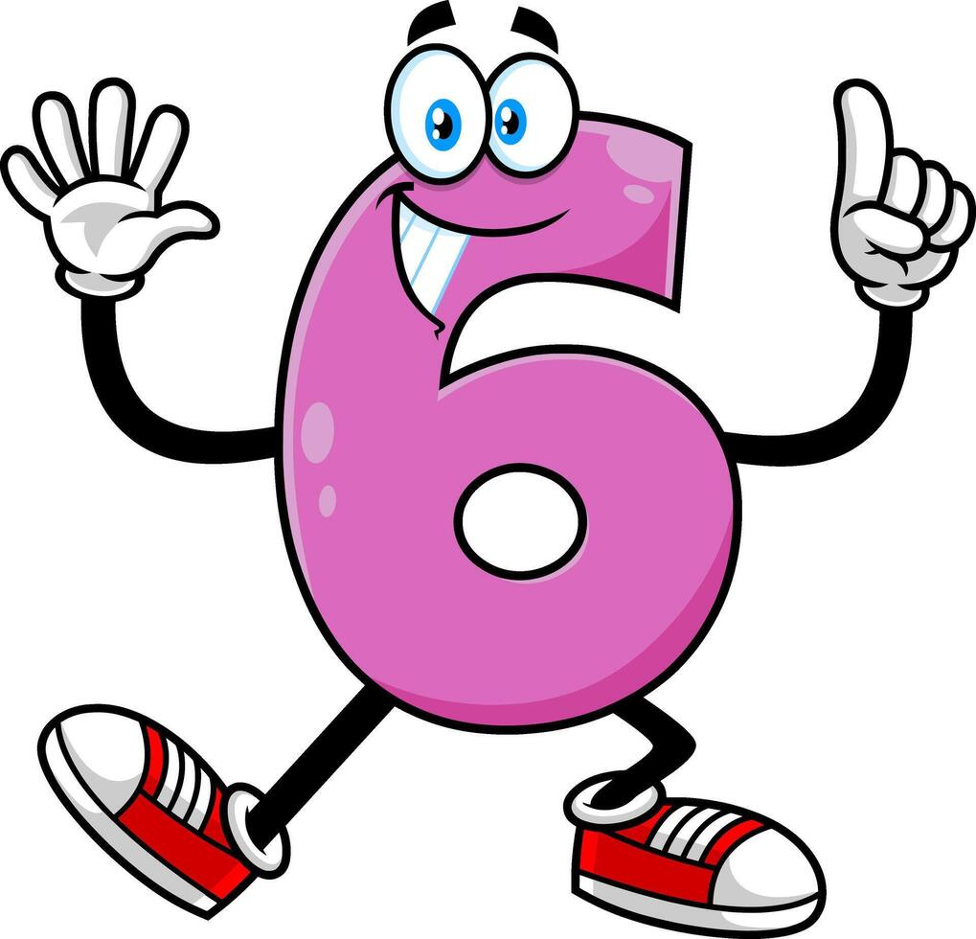
Πίνακας του 6
6 × 1 = 6
6 × 2 = 12
6 × 3 = 18
6 × 4 = 24
6 × 5 = 30
6 × 6 = 36
6 × 7 = 42
6 × 8 = 48
6 × 9 = 54
6 × 10 = 60

Slide 8

Πίνακας του 7
7 × 1 = 7
7 × 2 = 14
7 × 3 = 21
7 × 4 = 28
7 × 5 = 35
7 × 6 = 42
7 × 7 = 49
7 × 8 = 56
7 × 9 = 63
7 × 10 = 70

Slide 9

Πίνακας του 8
8 × 1 = 8
8 × 2 = 16
8 × 3 = 24
8 × 4 = 32
8 × 5 = 40
8 × 6 = 48
8 × 7 = 56
8 × 8 = 64
8 × 9 = 72
8 × 10 = 80

Slide 10

Πίνακας του 9
9 × 1 = 9
9 × 2 = 18
9 × 3 = 27
9 × 4 = 36
9 × 5 = 45
9 × 6 = 54
9 × 7 = 63
9 × 8 = 72
9 × 9 = 81
9 × 10 = 90

Slide 11
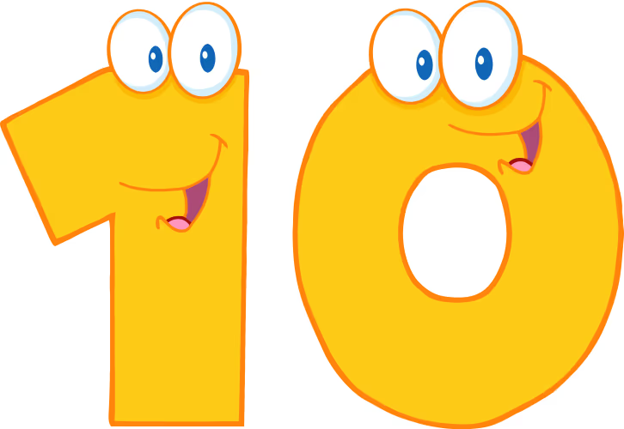
Πίνακας του 10
10 × 1 = 10
10 × 2 = 20
10 × 3 = 30
10 × 4 = 40
10 × 5 = 50
10 × 6 = 60
10 × 7 = 70
10 × 8 = 80
10 × 9 = 90
10 × 10 = 100

Slide 12

Ώρα για εξάσκηση!
Βρες τα αποτελέσματα:
3 × 4 = ?
5 × 2 = ?
6 × 3 = ?
9 × 1 = ?
10 × 4 = ?

